Slide 1



Arguments
Against The

Slide 2
1. Jesus taught to turn the other cheek (Matt. 5:39)
To individuals not governments
Being struck and sued, not killed
Emphasis on loving the way God has loved, refusing personal vengeance, working personal influence to win evil people to Christ
Parallel Romans 12:14-21 & Romans 13:1-4.

Slide 3
2. Woman caught in adultery was not condemned to die (Jn. 8:1-11)
Actually agrees with death penalty (8:7)
Must have two or more witnesses (Deut. 17:6; 19:15)
  Who were the witnesses?
Must be brought before appointed judges and officers (Deut. 16:18-20)

Slide 4
2. Woman caught in adultery was not condemned to die (Jn. 8:1-11)
The witnesses were to cast the first stone (Deut. 17:5)
  Likely those in the mob were guilty of the same thing (Rom. 2:1, 22)
Both the woman and the man were to be executed (Lev. 20:10)
  Why was only the woman brought forth?

Slide 5
3. David was not put to death for adultery or murder (2 Sam. 12:13)
  David recognized the justice of the penalty (12:5)
  God can choose to set aside the punishment
    doesn’t mean punishment is not just but that mercy is great
  David faced many other consequences for his action (12:10, 11, 14)

Slide 6
4. Capital punishment doesn’t deter crime
Primary goal is “punishment”
  “Put away evil” (Deut. 13:5; 17:7, 12; 1 Cor. 5:13; etc.)
Failed deterrence addressed in Ecclesiastes 8:11
Does deter!
  Is argued as saving lives (www.heritage.org/research/testimony/the-death-penalty-deters-crime-and-saves-lives)
  Deters the offender 100%!
  Deters others (Deut. 13:11; 17:12, 13; principle, 1 Tim. 5:20; Acts 5:11; 1 Cor. 5:6, etc.)

Slide 7
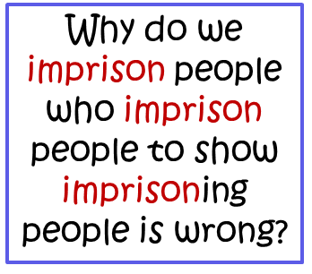

5. Capital punishment is cruel as the crime committed
Is not cruel but consequential
  Reap/sow (Gal. 6:7)
  In carrying out the sentence, the executioner is not guilty of the crime (Jos. 2:19; 1 Kin. 2:30ff; Num. 35:27)
“Cruel” is the crime that was committed against the innocent (Ezek. 18:18)
  Therefore his blood shall be upon his own head (Ezek. 18:10-18)

Slide 8
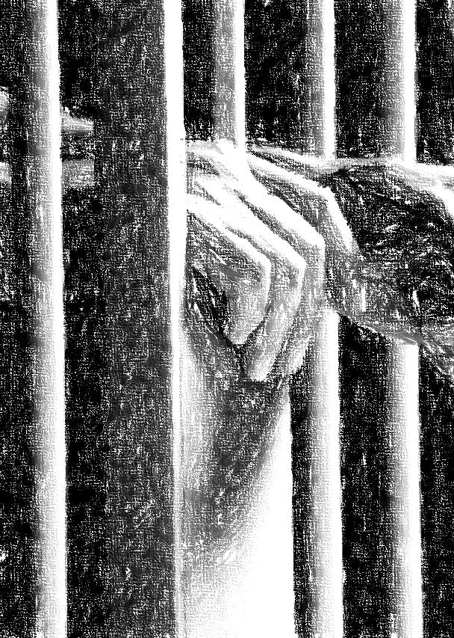
6. Why not life in prison instead?
Confusing “Life sentence” with “death sentence”
“…by man his blood shall be shed” (Gen. 9:6)

Slide 9

7. Jesus’ love doesn’t allow capital punishment
Becomes an argument against all punishment
Jesus endorsed capital punishment
  Parable (Lk. 19:27)
  Before Pilate
  (Jn. 19:11)
  Through apostles (Rom. 13:1ff; 1 Pet. 2:13, 14; Acts 25:11)

Slide 10

4 …"See, I have prepared my dinner; my oxen and fatted cattle are killed, and all things are ready. Come to the wedding."’
5 "But they made light of it and went their ways, one to his own farm, another to his business.
6 "And the rest seized his servants, treated them spitefully, and killed them.
7 "But when the king heard about it, he was furious. And he sent out his armies, destroyed those murderers, and burned up their city.
Matthew 22

Slide 11
Acts 3:14, “But you denied the Holy One and the Just, and asked for a murderer to be granted to you”
Acts 7:52, “Which of the prophets did your fathers not persecute? And they killed those who foretold the coming of the Just One, of whom you now have become the betrayers and murderers”

Slide 12
"But the cowardly, unbelieving, abominable, murderers, sexually immoral, sorcerers, idolaters, and all liars shall have their part in the lake which burns with fire and brimstone, which is the second death"
(Revelation 21:8)
the NEED exists for those who practice these things to hear the gospel and repent

Slide 13
Christianity
Acts 22:16
NOT FOR EVERYONE
‘And now why are you waiting? Arise and be baptized, and wash away your sins, calling on the name of the Lord.’

